Slide 1

Does a higher budget determine how lucrative a movie’s profit will be?
Team #3

Slide 2

Datasets
Popularity - Only 9,043 data available out of 84,294 titles
Netflix titles -568 titles with data available for only 44 original titles
Budget
Movie Titles
Revenue
Genres
IMDb Ratings
OMDb

Slide 3

Act 2 - Cass

Slide 4
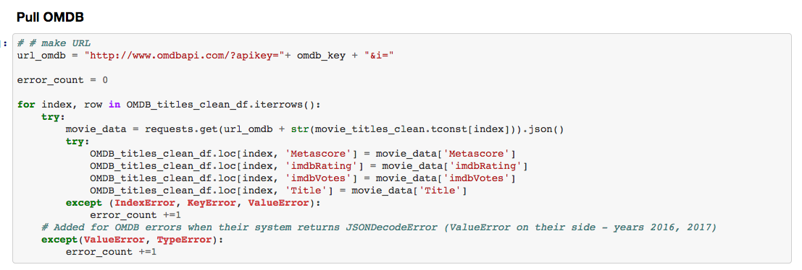

Slide 5
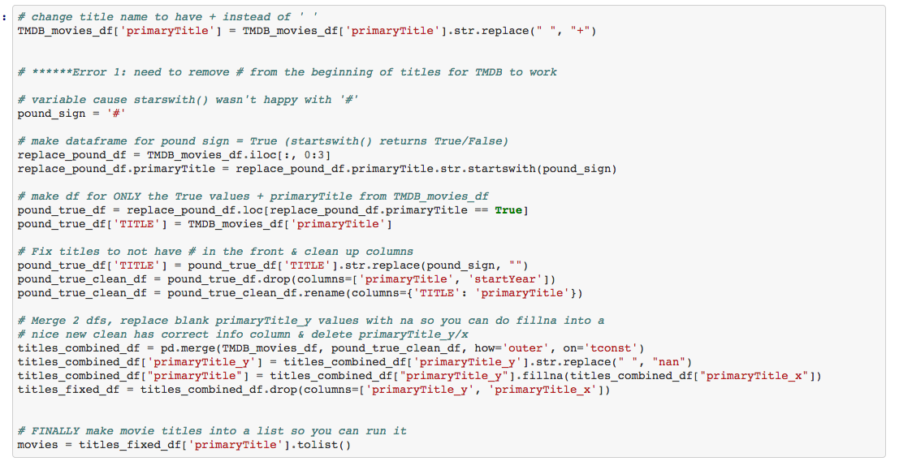

Slide 6
Act 3 – Sriven

Slide 7
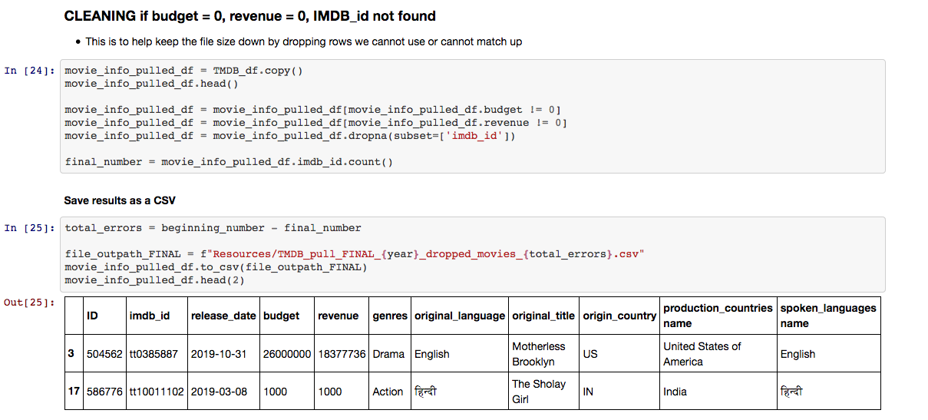

Slide 8
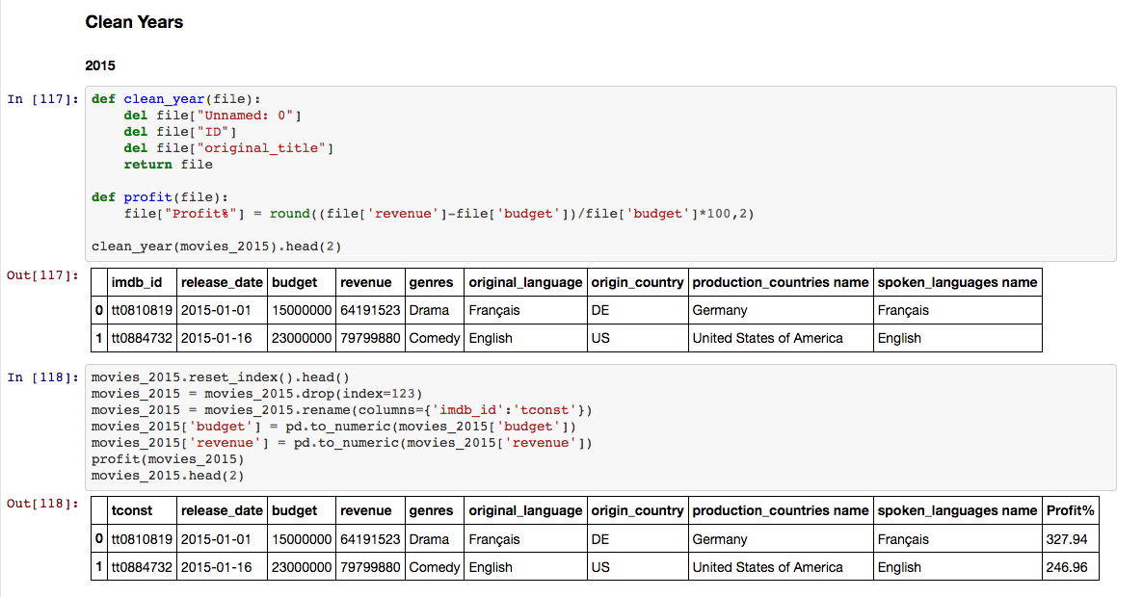

Slide 9

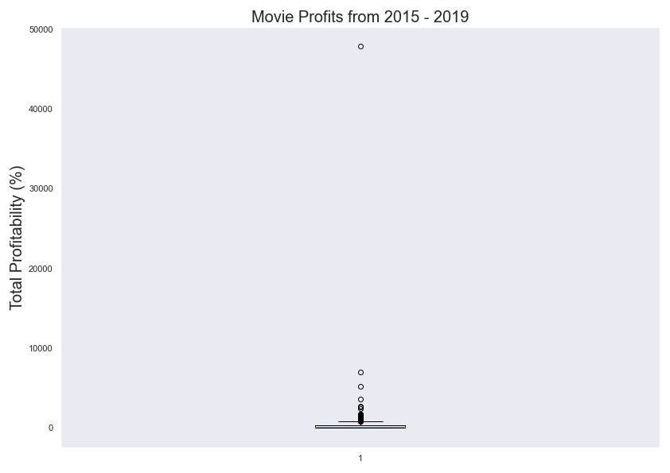
Identifying Outliers
Remove outliers
for analysis

Slide 10
Does a higher budget determine how lucrative a movie’s profit will be?
Which Genre yields the most profit?
Act 5 – Joshua

Slide 11

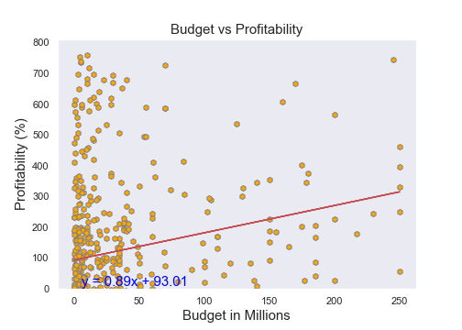

Slide 12

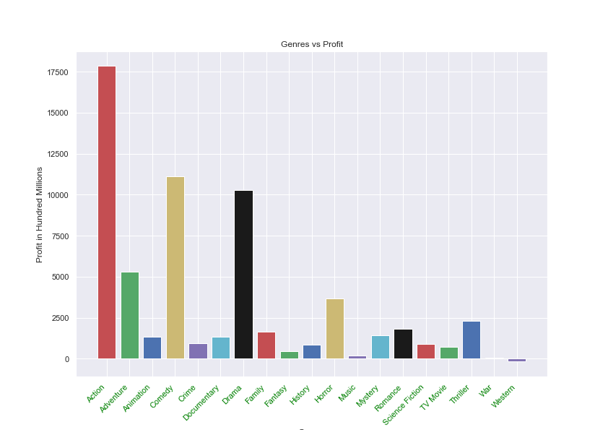

Slide 13
Do we find a correlation when we look at the top 3 genres?
Take 6 - Lindsey

Slide 14

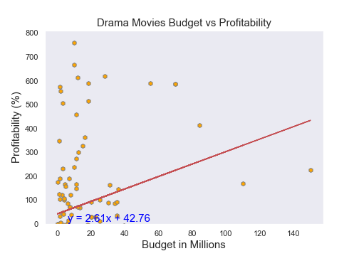
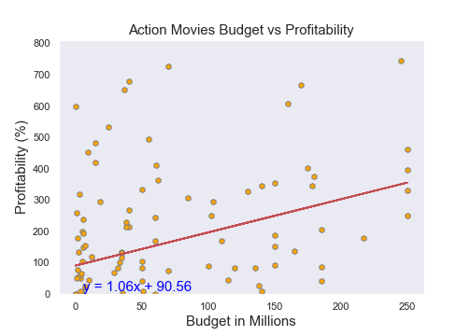
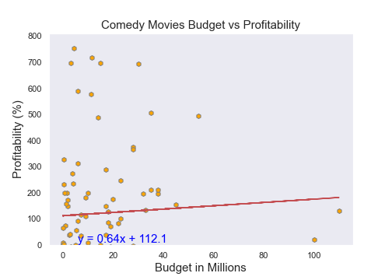

Slide 15
Is there a difference
between the US and Internationally?
Act 7 - Arpi

Slide 16

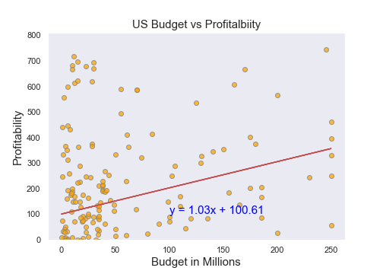
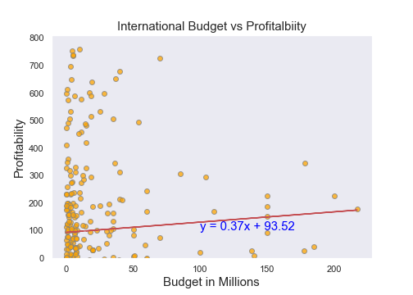

Slide 17

In conclusion
A larger budget does not automatically make a more lucrative movie.

Slide 18





Starring
Amandeep Brar Arpine Bankikyan Cassie Folkers
Lindsey Giron Ricardo Negrete Sriven Ankam
Featuring

